Slide 1
Hardware/Software Co-Programmable Framework for Computational SSDs to Accelerate Deep Learning Service on Large-Scale Graphs
Conference : FAST’2022
Author : Miryeong Kwon Donghyun Gouk Sangwon Lee Myoungsoo Jung
Research unit : Korea Advanced Institute of Science and Technology……

Slide 2
Research work—Background
Graph neural networks (GNNs) have recently emerged as a representative approach for learning graphs, point clouds, and manifolds.
In contrast to traditional deep learning, unique behaviors of the emerging GNNs are engaged with a large set of graphs and embedding data on storage, which exhibits complex and irregular preprocessing.

Slide 3
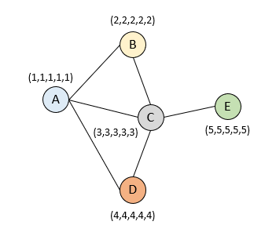
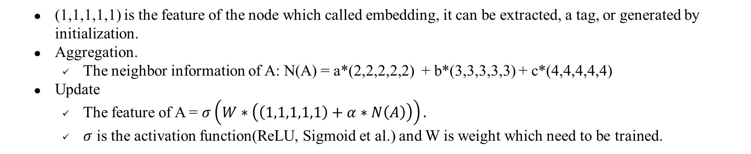
GNN
The procedure of GNN.
Aggregation.
Update.
Loop.
(1,1,1,1,1) is the feature of the node which called embedding, it can be extracted, a tag, or generated by initialization.
Aggregation.
The neighbor information of A: N(A) = a*(2,2,2,2,2) + b*(3,3,3,3,3) + c*(4,4,4,4,4)
Update
The feature of A = $σ\left(W∗\left(\left(1,1,1,1,1\right)+α∗N\left(A\right)\right)\right).$
$σ$ is the activation function(ReLU, Sigmoid et al.) and W is weight which need to be trained.
Notes:
首先就是聚合操作，聚合就是如果要做节点分类的话，只靠节点A(1,1,1,1,1)这些特征无法准确的对A进行分类，但是他和B C D都有关系，那么B C D的特征就能在一定程度上去决定A的类别，比如说A这个人有三个朋友B C D，那么A和B C D就有可能和B C D是一类人，所以当凭借一个结点的特征无法对他进行分类的时候，就凭借他的邻居来判断他，其实这就是GNN的一个核心思路。
那对节点A来说，B C D都是她的邻居，那么聚合就是将A节点的邻居信息进行整合，体现到公式上就是常数a乘上B的特征+常数b乘上C的特征+常数c乘上D的特征，其中a b c可以通过训练迭代地生成也可以通过手动设置。
聚合完后就是一个更新的操作，更新操作本质上就是将节点A的邻居信息黏合到A的特征中，$α和$权重W都是可训练的。最后得到的就是经过一层GNN后A的最终的信息。

Slide 4
GNN
The procedure of GNN.
Loop
After the first aggregation and update, a contains the features of node B, C and D, that is the 1-hop node.
After the second aggregation and update, since there is the information of E aggregated from the previous layer in C, at this time, A obtains the characteristics of the second-order neighbor E.
Notes:
因此经过一次聚合更新后，A中包含B C D的信息，B中有A C的信息，C中有A B D E的信息，D中有A C的信息，E中有C的信息。但是经过第二次聚合更新后，A在聚合C的信息的时候，C中有上一层聚合到的E的信息，此时A就获得了二阶邻居E的特征。那多层GNN就是为了得到多阶邻居节点的信息。

Slide 5
GNN
The function of GNN.
After aggregation, update and loop, we can obtain every node’s feature and then
perform the classification tasks,
perform the associated forecast tasks
by calculating the Loss of features and tag to update the parameters.
Notes:
因此经过一次聚合更新后，A中包含B C D的信息，B中有A C的信息，C中有A B D E的信息，D中有A C的信息，E中有C的信息。但是经过第二次聚合更新后，A在聚合C的信息的时候，C中有上一层聚合到的E的信息，此时A就获得了二阶邻居E的特征。那多层GNN就是为了得到多阶邻居节点的信息。
第一种应用就是分类任务，通过聚类、更新、循环等操作，我们可以得到一个节点的特征信息，在训练的时候每个节点都被打上了标签分了类，那最终可以直接利用得到特征值来计算Loss，用来更新前面的权重和各类参数。
第二种应用就是关联预测，比如说预测A和E有没有可能有关系，就可以直接将A的特征与E的特征拼接起来，去做关联分类，一样的计算Loss，一样的参数更新。
因此说，归根结底，GNN就是个提取特征的方法。

Slide 6
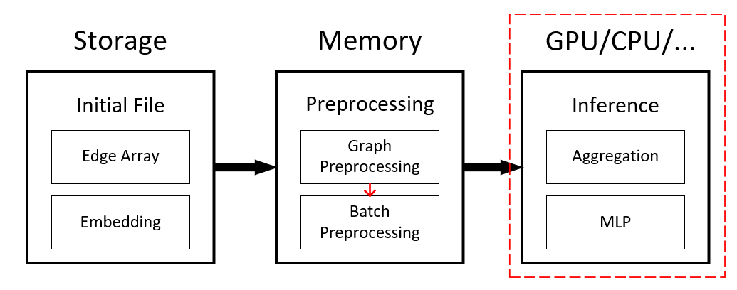
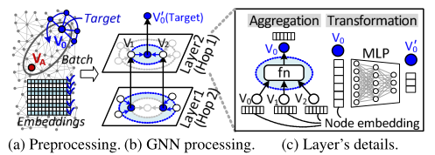
Research work—Problem
The pure inference latency, that all the previous GNN studies try to optimize, accounts for only 2% of the end-to-end inference service time.
The modern GNN models in practice sample a set of subgraphs and DL feature vectors (called embeddings) from the target graph information, and aggregate the sampled embeddings for inductive node inferences.
The graph information (graph and node embeddings) initially reside in storage and need to be loaded into working memory and reformatted in the form of an adjacency list before the actual inference services begin.
These activities take a significant amount of time since the graph information often exceeds hundreds of GBs or even a TB of storage.

Slide 7
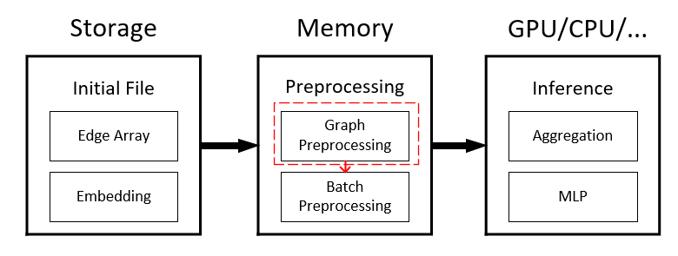
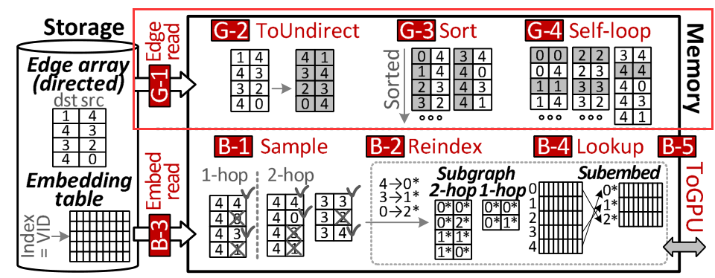
Research work—Problem
The dataset preprocessing takes up most of the delay.
The raw graph file includes an (unsorted) edge array, each being represented by a pair of destination and source vertex identifiers (VIDs).
Graph Preprocessing - obtain a sorted, undirected graph dataset.
Load the edge array (raw graph) from the underlying storage to the working memory.
Allocate a new array and copy the data from the edge array to the new array by swapping the destination and source VIDs for each entry ({dst, src}→{src, dst}).
Merge and sort the undirected graph, which turns it into a VID-indexed graph structure.
Inject self-loop information (an edge connecting a vertex to itself) to the undirected graph .

Slide 8
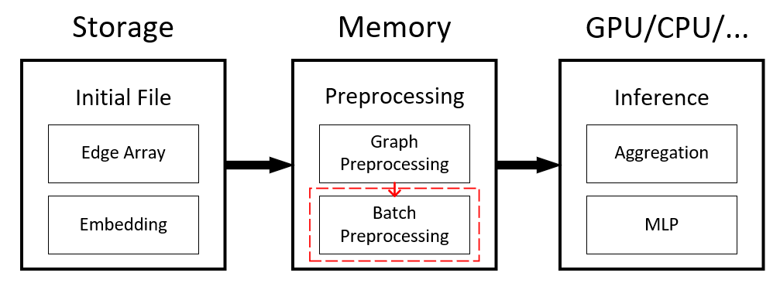
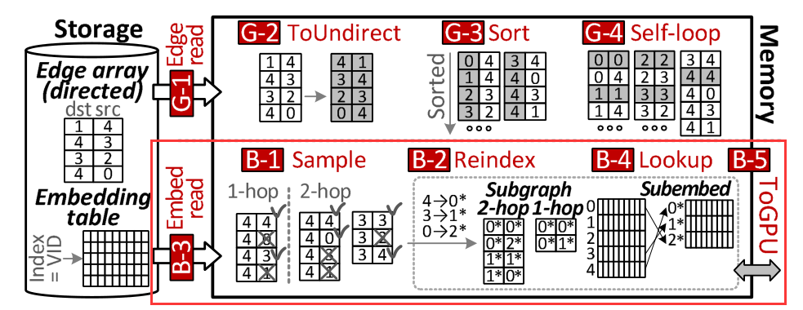
Research work—Problem
The dataset preprocessing takes up most of the delay.
Batch Preprocessing – perform node sampling.
Read all V4’s neighbors and extracts two nodes from the undirected graph (in a random manner).
For the sampled nodes (V4 and V3), it reads their neighbor nodes (2-hop) and samples the neighborhood again.
Since the number of nodes has been significantly reduced so then allocate new VIDs in the order of sampled nodes (4→ 0*, 3→ 1*, and 0→ 2*) and create L1 and L2 subgraphs for 2-hop and 1-hop neighbors, respectively.
Load the embeddings from the underlying storage to working memory.
Lookup the embeddings of L1’s subgraph (V4, V0, and V3).
The subgraphs and sampled embedding table are required to transfer from the working memory to the target GPU’s internal memory

Slide 9
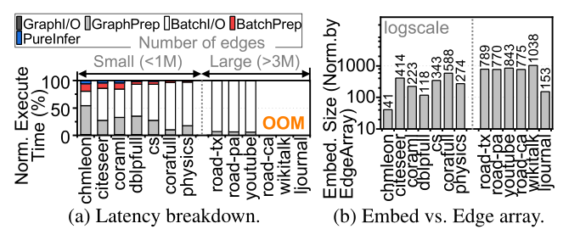
Research work—Problem
The dataset preprocessing takes up most of the delay.
Latency breakdown and embedding size vs edge array in End-to-End GNN execution.
Decompose the “end-to-end GCN inference” times across 14 real-world graph workloads into the latency of graph preprocessing (GraphPrep), batch preprocessing (BatchPrep), GCN inference processing (PureInfer), and storage accesses for graph (GraphI/O) and embeddings (BatchI/O).
BatchI/O accounts for 61% of the most end-to-end latency for the small graphs and with the graph size increases (>3 million edges), BatchI/O becomes the dominant contributor of the end-to-end GNN inference time (94%, on average).
GraphPrepalso consumes 28% of the end-to-end latency for these small graphs.
Embedding tables of the small and large graphs are greater than the edge arrays for those graphs by 285.7× and 728.1×, on average, respectively.

Slide 10
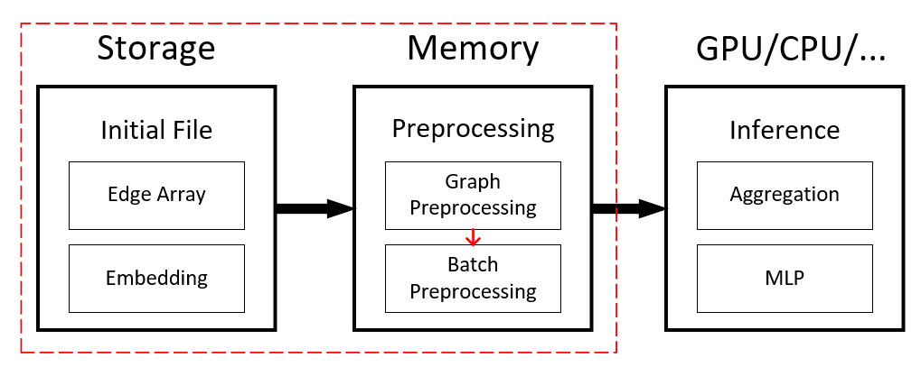
Research work—Solution
Propose HolisticGNN, a hardware and software co-programmable framework that accelerate GNN inference services near storage.

Slide 11
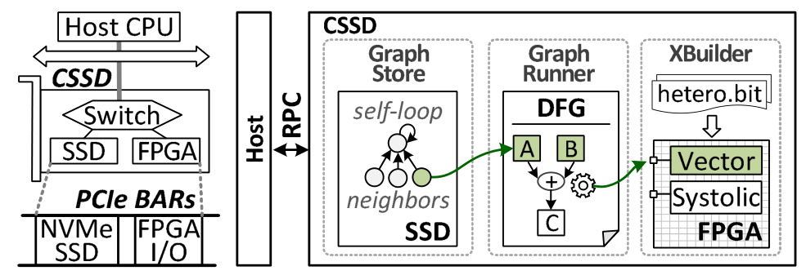
Research work—Technique
Overview of HolisticGNN.
In contrast to ISP(In-storage processing), they propose new concept of computational SSDs (CSSDs) decouples the computing unit from the storage resources by locating FPGA near SSD in the same PCIe subsystem (card) .CSSD allows the hardware logic fabricated in FPGA to access the internal SSD via the internal PCIe switch.
The host is responsible for writing/reading data on the SSD using the I/O region of NVMe protocol while giving the data’s block address to the FPGA through its own I/O region, whose address is designated by PCIe’s base address register.
CSSD allows the hardware logic fabricated in FPGA to access the internal SSD via the internal PCIe switch.
The HolisticGNN compose three major modules:
graph-centric archiving system (GraphStore)
programmable inference model (GraphRunner)
accelerator builder (XBuilder).

Slide 12
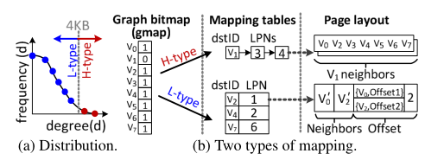
Research work—Technique
Graph-centric archiving system (GraphStore).
Prepare the target graph data and embeddings in a ready-to-access structure and then the tasks of graph preprocessing can immediately use without preprocessing the datasets.
Mapping Structure-GraphStore maintains the graph datasets as an adjacency list and an embedding table to handle the geometric information and feature vectors.
The embedding table is stored in sequential order (and thus it does not require page-level mapping).
The adjacency list is maintained in two different ways by considering the efficiency of graph searches/updates:i) high-degree graph mapping (H-type) and ii) low-degree graph mapping (L-type).
The power-law graph’s natures make a few nodes have severely heavy neighbor nodes (high-degree) .These high-degree nodes account for a small fraction of the entire graph, but they have a high potential to be frequently accessed and updated (because of their many neighbors)

Slide 13
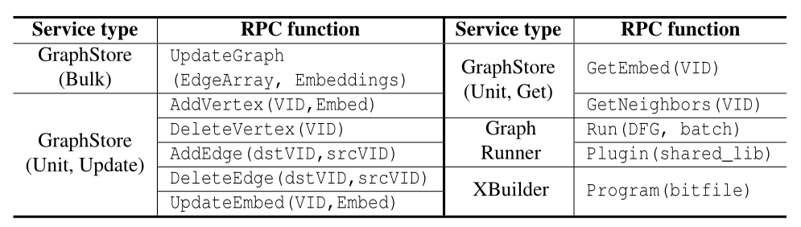
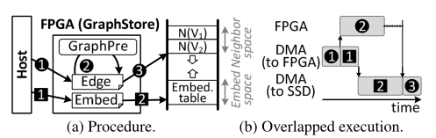
Research work—Technique
Graph-centric archiving system (GraphStore).
GraphStore offers two-way methods for the graph management, bulk operations and unit operations.
The bulk operations allow users to update the graph and embeddings with a text form of edge array and embedding list.
For the bulk operations, GraphStore converts the incoming edge array to an adjacency list in parallel with transferring the embedding table, and it stores them to the internal SSD.
When an edge array (graph) arrives, GraphStore performs graph preprocessing and flushes pages for the graph and begins to write the embedding table into the embedding space in a sequential manner while preprocessing the graph.
This can make heavy storage accesses (associated with the embeddings) entirely overlap with the computation burst of graph preprocessing (associated with adjacency list conversions).

Slide 14
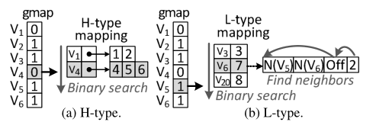
Research work—Technique
Graph-centric archiving system (GraphStore).
GraphStore offers two-way methods for the graph management, bulk operations and unit operations.
GraphStore’s unit operations support mutable graph management corresponding to individual vertex/edge updates or queries.
Find out the node’s neighbors.

Slide 15
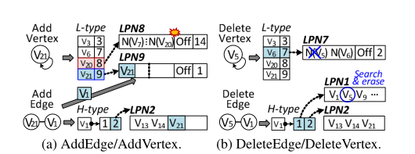
Research work—Technique
Graph-centric archiving system (GraphStore).
GraphStore offers two-way methods for the graph management, bulk operations and unit operations.
GraphStore’s unit operations support mutable graph management corresponding to individual vertex/edge updates or queries.
Find out the node’s neighbors.
Add operation and delete operation.

Slide 16
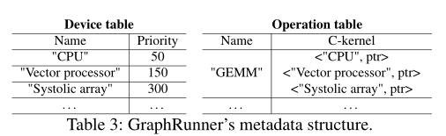
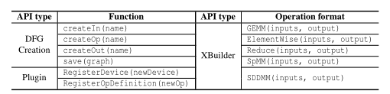
Research work—Technique
Programmable inference model(GraphRunner).
To program a GNN model and its end-to-end service, the users can write a DFG(dataflow graph) and download/execute to CSSD.
GraphRunner decouples CSSD task definitions from their actual implementations, which are called C-operation and C-kernel.
C-kernel registration and management.
GraphRunner has two metadata structures, Device table and Operation table.
The device table includes currently registered device names and the corresponding priority.
The operation table maintains C-operation names and the address pointers of their C-kernel implementation.
When users implement a C-kernel, it should invoke two registration interface methods of the Plugin library,RegisterDevice() and RegisterOpDefinition(), at its initial time. RegisterDevice() configures the priority value of the device that users want to execute for any of C-kernels (e.g., “V ector processor”, 150).

Slide 17
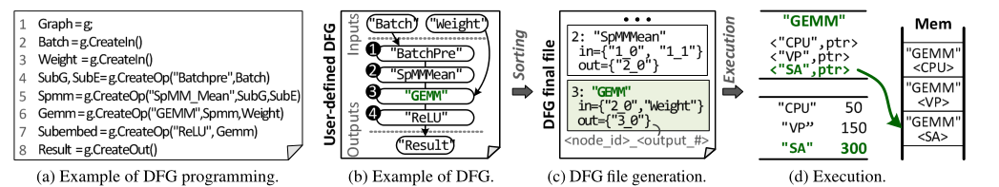
Research work—Technique
Programmable inference model(GraphRunner).
Handling computational graphs.
DFG management interfaces of the CSSD library (CreateIn(), CreateOut() and CreateOp()) are used for explaining how C-operations are mapped to DFG’s nodes and how their input and output parameters are connected together.
BatchPre is the first C-operation that takes Batch as its input ( 1 ), and the result is forwarded to SpMM_Mean C-operation ( 2 ), which performs GCN’s average-base aggregation. Then, the result of SpMM_Mean is fed to GCN’s transformation consisting of GEMM (having Weight) and ReLU C-operations ( 3 / 4 ).
GraphRunner then sorts the calling sequence of CSSD library interfaces and generates a markup file.
The host can run CSSD with the pro-grammed GNN by downloading the corresponding DFG and a given batch through Run() .

Slide 18
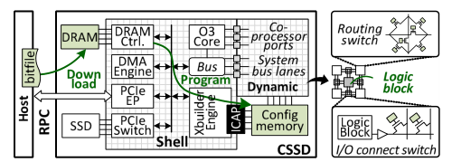
Research work—Technique
Accelerator builder(Xbuilder).
The CSSD’s hardware logic die is divided into two groups, Shell and User logic.
Shell logic associated with irregular tasks of GNN management, including GraphStore and GraphRunner executions.
User logic for users to reprogram the hardware in accelerating GNN algorithms.
FPGA only allows the users to reprogram the configuration memory only through the primitive hardware port, ICAP.
XBuilder copies the bitfile into CSSD’s FPGA internal DRAM first, and then, it reconfigures User logic by programming the logic using the bitfile via ICAP .

Slide 19
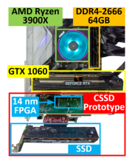
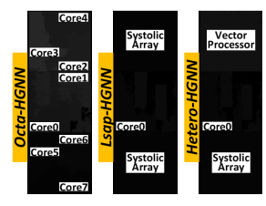
Research work—Evaluation
Prototypes.
Pototype a customized CSSD that employs a 14nm 730MHz FPGA chip, 16GB DDR4-2400 DRAM, and a 4TB high-performance SSD together within the same PCIe 3.0×4 subsystem.
Prepare three sets of hardware accelerators for XBuilder’s User logic; a multi-core processor (Octa-HGNN),large systolic array processors (Lsap-HGNN), and a hetero-geneous accelerator having a vector processor and a systolic array (Hetero-HGNN).
Octa-HGNN employs eight out-of-order (O3) cores and performs all GNN processing using multi-threaded software.
For Lsap-HGNN and HeteroHGNN, they modify an open-source SIMD and systolic architecture. The SIMD employs four vector units, and the systolic architecture employs 64 floating-point PEs with 128KB scratchpad memory.
For a fair performance comparison, they prepare two high-performance GPUs, GTX 1060 and RTX 3090. While GTX 1060’s 10 streaming multiprocessors (SMs) operate at 1.8GHz with 6GB DRAM, RTX 3090 employs 82 SMs working at 1.7 GHz with 24GB DRAM.

Slide 20
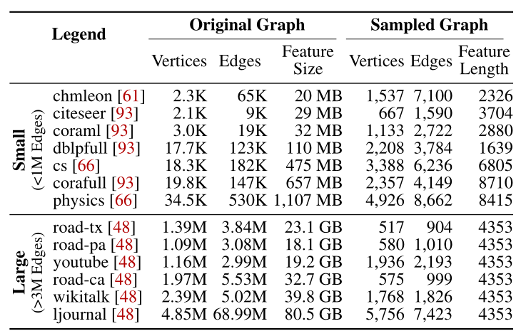
Research work—Evaluation
Prototypes.
GNN model and dataset.
Implement three popular GNN models, GCN, GIN, and NGCF.
Select 14 real-graph datasets (workloads) from LBC, MUSAE, and SNAP.

Slide 21
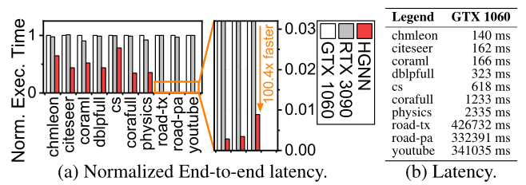
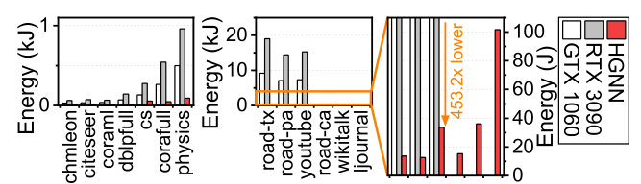
Research work—Evaluation
End-to-end Performance Comparisons.
Overlay Latency.
HGNN shows 7.1×and 7.0× shorter end-to-end latency compared to GTX 1060 and RTX 3090 across all the graph datasets except for road-ca, wikitalk, and ljournal because both GTX 1060 and RTX 3090 cannot execute such large-scale graphs due to the out-of-memory issue.
Energy Consumption.
HGNN exhibits 33.2× and 16.3× better energy consumption behaviors compared to RTX 3090 and GTX 1060, on average because of the low watts of the FPGA.

Slide 22
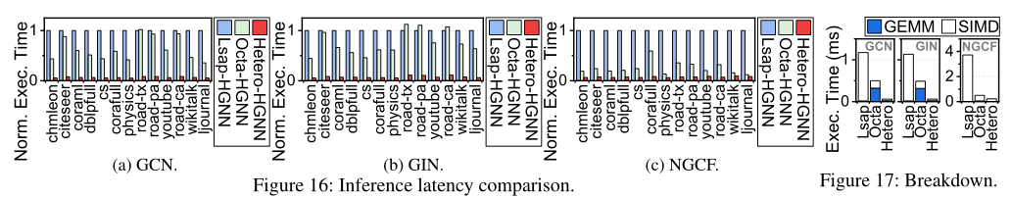
Research work—Evaluation
Pure Inference Acceleration Comparison.
The pure inference performance of Hetero-HGNN and Octa-HGNN, normalized to Lsap-HGNN.
Octa-HGNN exhibits shorter GNN inference latency compared to Lsap-HGNN by 2.17×, on average.
The conventional DL hardware acceleration is not well harmonized with GNN inference services. Since the computation of aggregation is involved in traversing the graph data, the systolic arrays (bigger than any hardware logic that we tested) cannot unfortunately accelerate the inference latency.
Hetero-HGNN shortens the inference latency of Octa-HGNN and Lsap-HGNN by 6.52× and 14.2×, on average.
The performance of Octa-HGNN is also limited because matrix computation on dense embeddings (GEMM) is not well accelerated by its general cores.
In contrast, Hetero-HGNN has both SIMD and systolic array units.

Slide 23
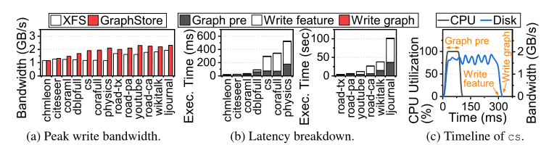
Research work—Evaluation
Perform analysis on GraphStore.
Bulk operation.
GraphStore shows 1.3× better bandwidth on graph updates compared to conventional storage stack.
the GPU-enabled host system writes the edge array and corresponding embeddings to the underlying SSD through its storage stack, GraphStore directly writes the data to internal storage without any storage stack involvement.
GraphStore starts the preprocessing as soon as it begins to write the embeddings to the internal SSD. Graph pre finishes at 100ms while Write feature ends at 300ms. Thus, Write feature is performed with the best performance of the internal SSD.

Slide 24
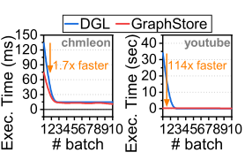
Research work—Evaluation
Batch preprocessing.
Batch preprocessing, which is the only task to read (sub)graphs from the storage in the end-to-end viewpoint; node sampling and embedding lookup use GetNeighbor() and GetEmbed().
For the earliest batch preprocessing, GraphStore performs batch preprocessing 1.7× (chmleon) and 114.5× (youtube) faster than that of the GPU-enabled host.
Hetero-HGNN shortens the inference latency of Octa-HGNN and Lsap-HGNN by 6.52× and 14.2×, on average.

Slide 25
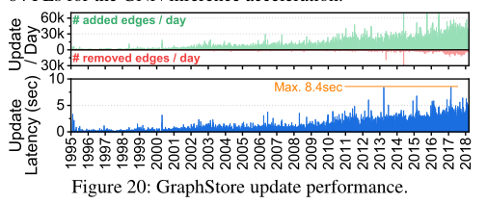
Research work—Evaluation
Mutable graph suooprt(Unit Operations).
The top of Figure 20 shows the number of per-day add and delete operations for the past 23 years (1995∼2018), and its bottom shows the corresponding per-day (accumulated) latency of GraphStore.
The workload adds 365 new nodes and 8.8K new edges into GraphStore, and deletes 16 nodes and 713 edges per day, on average.
GraphStore exhibits 970ms for per-day updates, on average, and the accumulated latency in the worst case of GraphStore is just 8.4 sec, which takes reasonably short in the workload execution time (0.01%).

